Slide 1

Group Members:
Dawood Ali
Taha Naeem
Ammar Ali
FaHAD JAWED
Student1206801
Student1205772
Student1206776
Student1204149

Slide 2
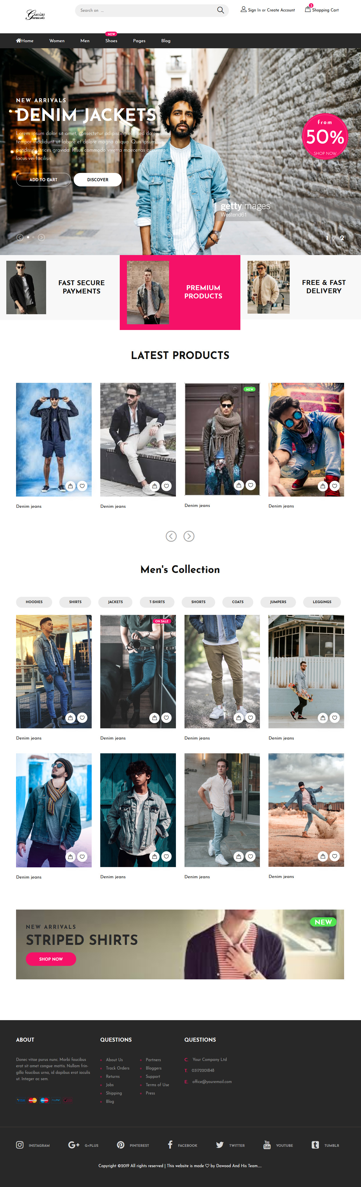
HOME PAGE
This is our home page.
It show’s our model.
Then how many Awards we got.
At last Footer with few links.

Slide 3
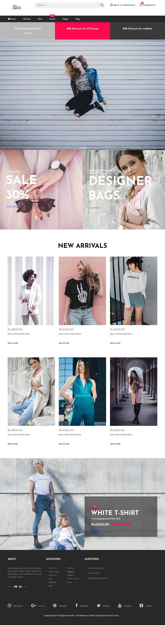
Women
This is our Women page.
It show’s our model.
Then how many Women Products We have.

Slide 4
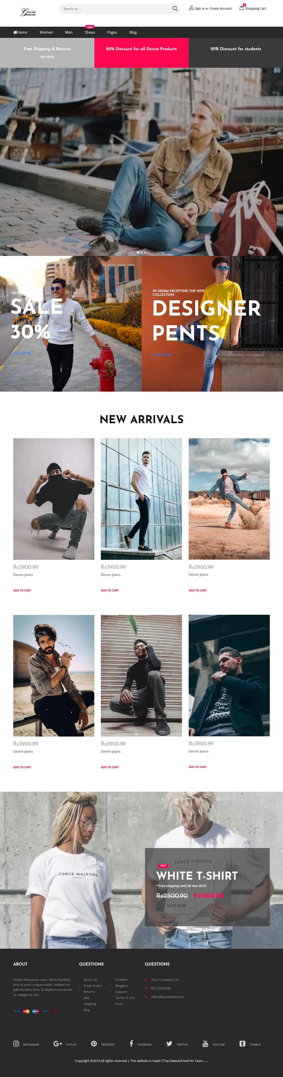
Men’S
This is our MEN page.
It show’s our model.
Then how many MEN’S PRODUCTS WE HAVE.

Slide 5
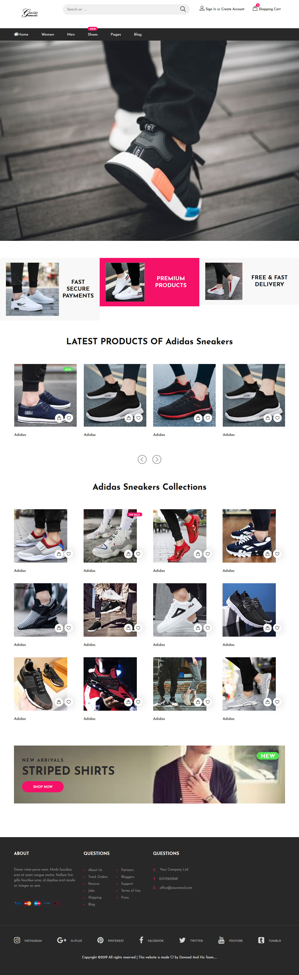
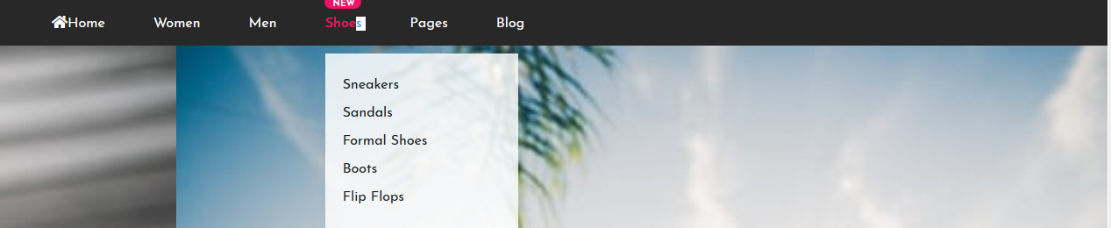
Shoes
This is our SHOES page.
It show’s our BEST SHOES.
Then how many Shoes PRODUCTS and brands WE HAVE.

Slide 6
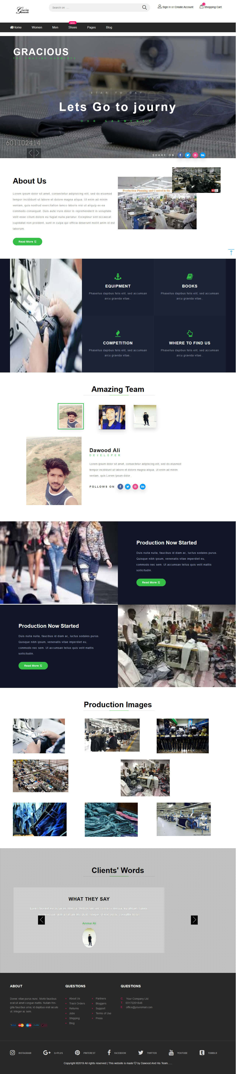
Discover
This is our Discover page.
It show’s our branches.
It show’s our GARMENT how we Makes this Amezing Products.

Slide 7
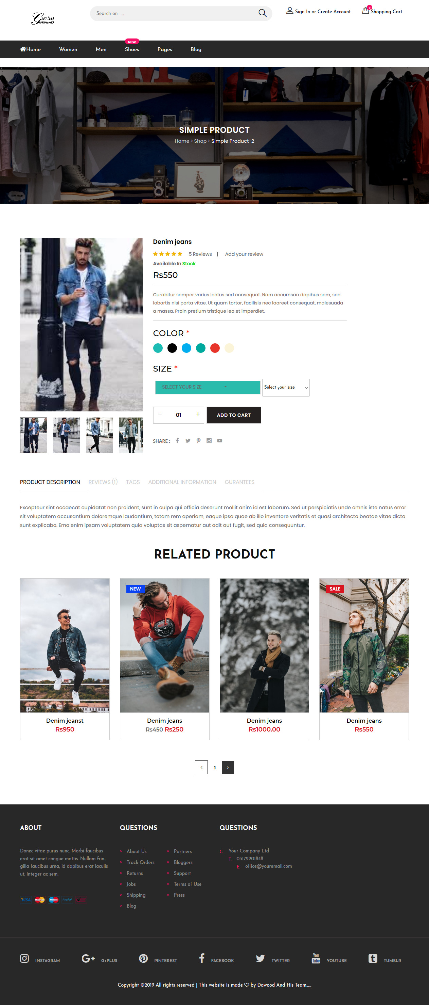
Products
This is our Products section.
It show’s our products .
You can buy any type of products you want.

Slide 8
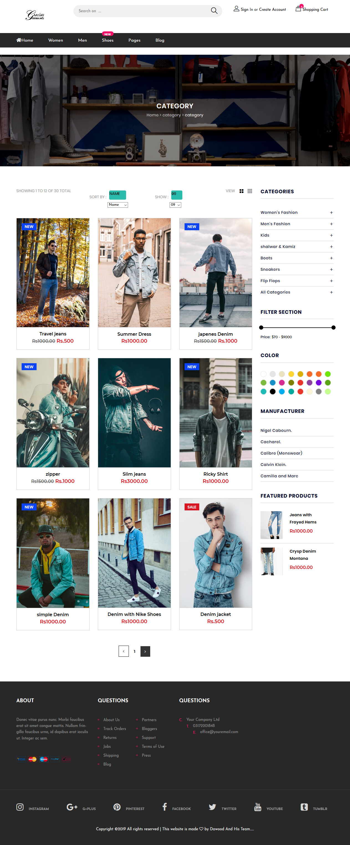
Categories
This is our categories .
We have a lot of categories.
You can see yourself like this if you buy right products from us.

Slide 9
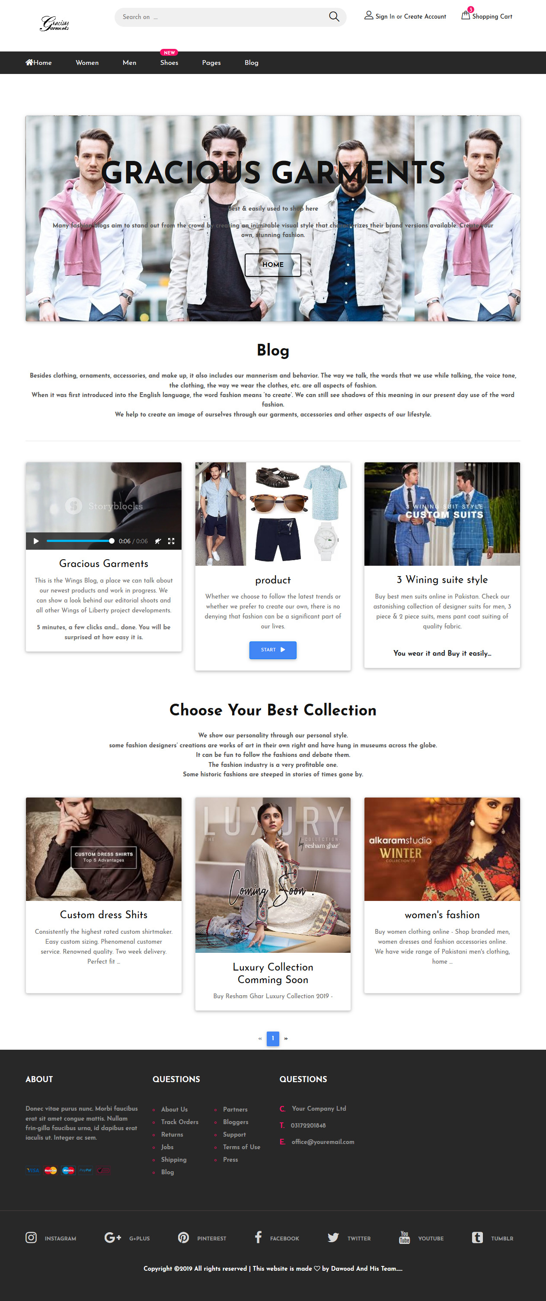
BLOG
This is our Blog Page.
It show’s our brand’s Details.
It show’s how We Made This Brand..

Slide 10
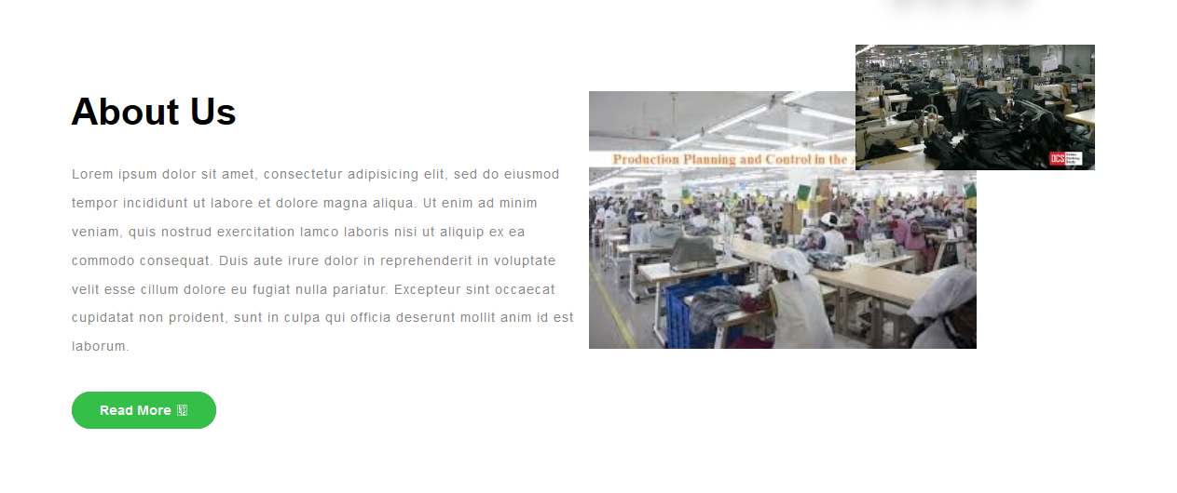
About us
This is our About Us page.
It show’s our branches.
It show’s our history how we started this business.

Slide 11
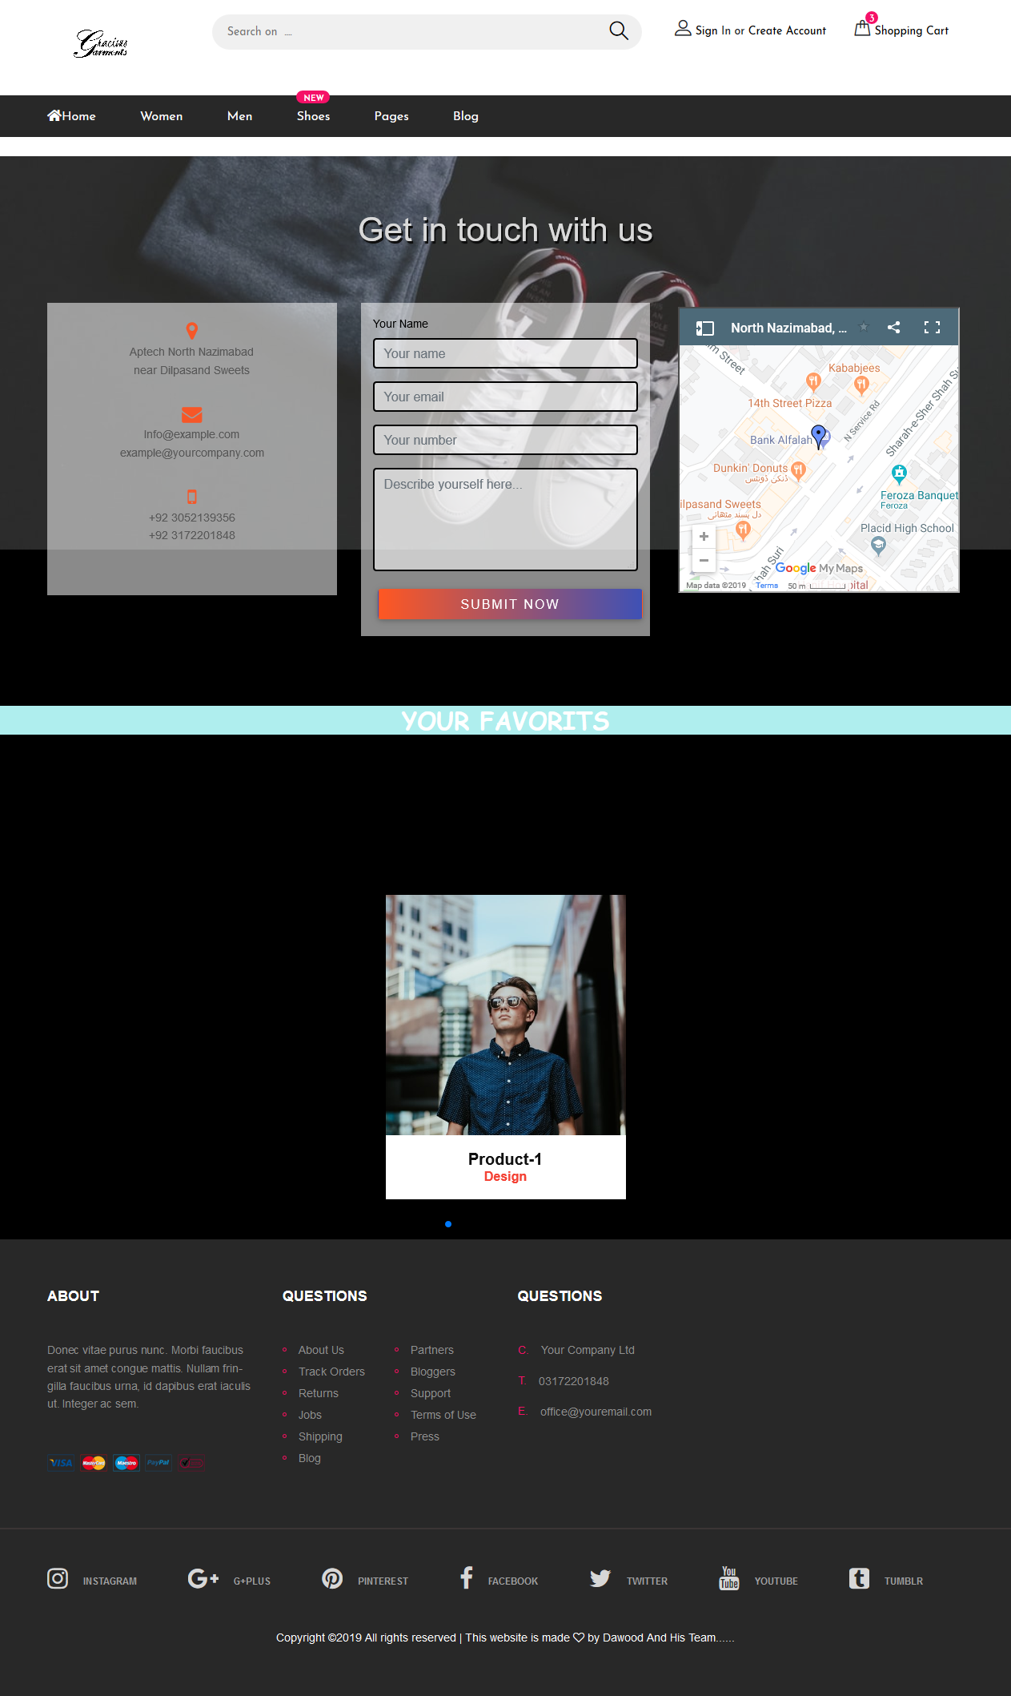
Contact us
This is our Contact us page.
You can send feedback form.
You can locate us from map.
It show’s our number , timings & email address.

Slide 12
Ending the presentation
We would like to thank our faculty Miss Rabiya Amin for guiding us on this whole E-Project.
This is our great experience for working as a team it teaches us how to work together.
THANK YOU.

